Slide 1


Front-end Tools
HTML
CSS
The backbone of every web page, HTML provides the structure and semantic elements to create a rich user interface.
CSS empowers styling and visual enhancements, enabling captivating designs and a pleasing user experience.
JavaScript
Bootstrap
JavaScript adds interactivity and dynamic functionality, making web applications more engaging and responsive.
This popular front-end framework provides a responsive grid system and pre-designed components for faster development.

Slide 2
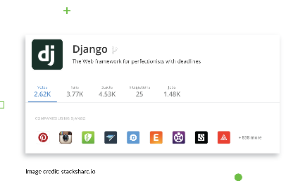

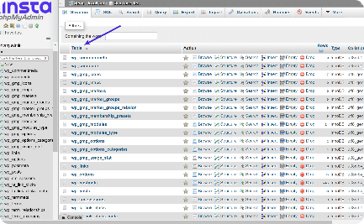
Back-end Tools
Django
Python
MySQL Lite3 Database
A high-level Python web framework that simplifies the development of robust and scalable back-end solutions.
A versatile programming language known for its readability and extensive libraries, ideal for implementing complex logic.
A lightweight, yet powerful, relational database management system that ensures efficient data storage and retrieval.

